Slide 1
The “Greatest” Carry Trade Ever? Understanding Eurozone Bank Risks
Viral V. Acharya (NYU Stern, CEPR and NBER)
and
Sascha Steffen (ESMT)
January 2014

Slide 2
Motivation
The European banking system is highly interconnected with the health of the sovereigns through the holdings of their debt
Domestic as well as cross-country holdings of sovereign debt.
Since mid-2008, government bond yield spreads between pairs of European countries have widened considerably, mirroring the economic divergence between these countries.
Banks have experienced significant losses and market-value declines.
Have banks been affected due to purely passive exposures to the troubled periphery sovereigns? Or did banks actively seek risky sovereign bonds? Which banks actively sought risky sovereign bonds? Can this behavior be understood using market data?
Understanding bank risks can help understand how to “fix” banks

Slide 3
Figure 1.B. Pairwise Comparison of Government Bond Yield Spreads: Spain versus Germany
This graphic shows the time series of 10-year government bond yields comparing Spanish and German 10-year government bond yields since January 2005 (Source: Bloomberg).
A
A++A
BBB+

Slide 4
“Carry Trades“ in Peripheral Sovereign Bonds
(Our results suggest that) Bank risk in this period can be understood as reflecting a “carry trade“ behavior
Financing leg: short-term wholesale market
Investment leg: long-term GIPSI government bonds
Carry trade reflects a bet on the economic convergence of the Eurozone and a convergence of the spread between the two legs
Banks gain on the upside when yields of GIPSI countries decrease (and market prices increase), i.e. banks can pocket the “carry”
Bank lose on the downside when spreads between both legs diverge further:
Sale of bonds at lower prices
Market-to-market positions in trading portfolios
Costs of ST funding goes up
Lower collateral available in private repo markets
Why would banks engage (or sustain) such an economic exposure?

Slide 5
Main Hypothesis
European banks search for yield through investments in high yielding risky sovereign debt financed with short-term funding.
Under-capitalized banks have an incentive to shift into riskier assets holding risk weights constant (“risk shifting”).
Caballero, Hoshi and Kashyap, 2008; Giannetti and Simonov, 2013
Current regulatory capital requirements in fact incentivize such behavior by treating most sovereign bonds as safe and ignoring short-term funding.
Basel II assigns zero risk weights for holding sovereign debt increasing incentives for under-capitalized banks to hold these assets (“regulatory arbitrage”).
European banks can use securities to obtain funding from the ECB.
Phenomenon should pervade European banks, not just a “home bias”

Slide 6
Dexia S.A. – A Carry Trade Gone Bad
"And of course, the deterioration of the Euro zone situation and particularly the sovereign crisis in the peripheral economies hit very badly the group. And that's of course not a surprise for a group that still had very important short-term funding needs that was mainly present in strong exposures in peripheral countries. [...] Before 2008, it was the group's high rating granting easy access to wholesale funding that led to the situation of October 2008 with short-term funding need of €260 billion outstanding in October 2008, i.e. 43% of total balance sheet. [...] with very significant acceleration and buildup of the bond portfolio was amounting at €203 billion at the end of 2008. Mostly carry-trades with marginal improvement of customer access [...] that led to a very significant gearing ratio because the portfolio size was, at that time, 25 times the group equity."
(Pierre Mariani, Chairman-Management Board & CEO, Dexia SA, Earnings Call, February 23rd, 2012)

Slide 7
Two Examples – Dexia S.A. and Bank of Cyprus
Dexia had invested about 5-6 time its 2008 book equity in GIPSI sovereign debt
Dexia lost about EUR 80 billion short-term funding and deposits between March and October 2011 (US MMF, institutional investors, retail investors)
Plus had to post about EUR 15 billion in cash collateral as margin for hedges -> Dexia was long fixed interest rates hedged with interest rate swaps
Bank of Cyprus (BOC) quadrupled its investment in Greek government bonds in 2010 to EUR 2.4 billion
Greek sovereign debt among highest yielding bonds
Non-performing loan portfolio eroded profitability of BOC
„Absolute value“ strategy to increase net interest income, „relative value“ strategy to opportunistically sell bonds to generate gains around reporting dates („window dressing“)
Notes:
However, we believe that the CEO of Dexia, the failed Benelux bank, may have blown GB's trade out of the water. The Belgian paper De Standard is reporting that Dexia was bought down by short bund position in Interest Rate Swaps that they "forgot" to hedge, resulting in a single margin call of 46 Billion Euros. Single handedly bankrupting the bank. Ouch!

Slide 8
Bank of Cyprus: Daily Trading in Greek Sovereign Debt

Slide 9
Bank of Cyprus: Daily Trading in Greek Sovereign Debt by ISIN
(1) | (2) | (3) | (4) | (5) | (6) | (7)
ISIN | Residual Maturity | Purchase | Sale | Price | Date | Gain / Loss
GR0002069327 | 0.5 | 40,000,000 |  | 0.9877 | 15.01.2009
GR0002069327 | 0.5 | 25,000,000 |  | 0.9877 | 15.01.2009
GR0002069327 | 0.5 |  | 65,000,000 | 0.9938 | 11.03.2009 | 396,500
GR0114019442 | 2.4 |  | 95,000,000 | 1.0099 | 20.03.2009
GR0114022479 | 5.5 | 40,000,000 |  | 0.9935 | 21.02.2009
GR0114022479 | 5.5 |  | 1,200,000 | 0.9935 | 23.01.2009 | 0
GR0114022479 | 5.5 |  | 3,000,000 | 0.9940 | 28.01.2009 | 1,500
GR0114022479 | 5.5 |  | 2,000,000 | 0.9990 | 28.01.2009 | 11,000
GR0114022479 | 5.5 |  | 5,000,000 | 1.0100 | 30.01.2009 | 82,500
GR0114022479 | 5.5 |  | 4,000,000 | 1.0098 | 02.02.2009 | 65,200
GR0114022479 | 5.5 |  | 2,000,000 | 1.0098 | 02.02.2009 | 32,600
GR0114022479 | 5.5 |  | 500,000 | 1.0080 | 02.02.2009 | 7,250
GR0114022479 | 5.5 |  | 22,300,000 | 1.0345 | 23.03.2009 | 914,300
GR0114022479 | 5.5 | 200,000,000 |  | 1.0223 | 31.03.2009
GRO 124028623 | 7.3 | 40,000,000 |  | 0.8915 | 20.02.2009
GRO 124028623 | 7.3 |  | 40,000,000 | 0.9035 | 23.03.2009 | 480,000
GRO 124031650 | 10.2 | 175,000,000 |  | 0.9893 | 04.03.2009
GRO 124031650 | 10.2 |  | 1,000,000 | 0.9999 | 09.03.2009 | 10,600
GRO 124031650 | 10.2 |  | 2,000,000 | 1.0005 | 10.03.2009 | 22,400
GRO 124031650 | 10.2 |  | 172,000,000 | 1.0014 | 13.03.2009 | 2,081,200
GR0110021236 | 3 | 25,000,000 |  | 0.9976 | 10.02.2009
GR0110021236 | 3 |  | 25,000,000 | 1.0018 | 11.03.2009 | 105,750
GR0512001356 | 3.9 | 200,000,000 |  | 0.9995 | 06.02.2009
GR0512001356 | 3.9 | 100,000,000 |  | 0.9907 | 11.03.2009
GR0512001356 | 3.9 | 172,000,000 |  | 1.0014 | 13.03.2009
XS0372384064 | 4.2 | 7,721,000 |  | 0.9905 | 17.03.2009
 |  | 1,024,721,000 | 440,000,000 |  |  | 4,210,800
 | Difference | 584,721,000

Slide 10
In this Paper
We show that this behavior was pervasive among European banks
Long peripheral sovereign bonds financed in short-term wholesale markets
Our results are supportive of moral hazard in the form of risk-taking by under-capitalized banks to exploit low risk weights
Regulatory capital arbitrage, risk shifting
We discuss alternative hypothesis
Inertia, home bias, moral suasion
We show that riskier banks not only hold more GIPSI sovereign debt but have also increased their portfolio holdings from March 2010 to December 2010, until the stress tests „shocked“ sovereign bond holdings.
The ‘home bias’ of peripheral banks has increased over time, esp. post-LTRO

Slide 11
Data
We start with all publicly listed banks that participated in the EBA stress tests
Overall, 56 banks included in our analysis
We collect market information from Bloomberg for all EBA public banks
Stock prices, sovereign bond yields, bank CDS spreads
The European Banking Authority (EBA) disclosed information about banks‘ bond portfolio after the 5 stress tests
March 2010, December 2010, September 2011, December 2011, June 2012
Financial information of banks from SNL Financial and annual and quarterly reports from banks (ECB funding, repo transactions)
Further data sources: S&P, ECB, BIS
US Money Market Fund data from SEC (Rule 2a-7) filings starting Nov’10

Slide 12
Table 2. Summary Statistics of Bond Holdings
 | GIPSI | Greece | Italy | Portugal | Spain | Ireland
Non-GIPSI banks
March 2010 | 212,928 | 34,814 | 115,472 | 14,776 | 29,190 | 18,677
December 2010 | 222,587 | 28,208 | 132,803 | 14,636 | 41,923 | 5,017
September 2011 | 172,827 | 21,832 | 103,137 | 13,975 | 30,039 | 3,845
December 2011 | 122,828 | 17,355 | 69,243 | 10,390 | 22,311 | 3,528
June 2012 | 104,761 | 1,672 | 69,344 | 10,169 | 20,615 | 2,961
GIPSI banks
March 2010 | 373,348 | 60,098 | 149,028 | 12,378 | 145,643 | 6,201
December 2010 | 416,272 | 57,351 | 171,196 | 16,162 | 158,360 | 13,204
September 2011 | 342,175 | 2,747 | 164,082 | 14,748 | 147,427 | 13,171
December 2011 | 296,787 | 2,585 | 153,964 | 11,877 | 115,563 | 12,799
June 2012 | 347,467 | 146 | 189,550 | 15,430 | 127,807 | 14,533
GIPSI and non-GIPSI banks increased their exposure to Italy and Spain between March 2010 and December 2010.
GIPSI banks increase holdings of Italian and Spanish government debt after LTROs.

Slide 13
Table 2. Summary Statistics of Bond Holdings (cont’d)
 | Non-GIPSI | Germany | France
Non-GIPSI banks
March 2010 | 611,120 | 160,090 | 90,451
December 2010 | 936,117 | 244,593 | 145,961
September 2011 | 882,506 | 229,328 | 141,358
December 2011 | 771,676 | 206,187 | 116,094
June 2012 | 824,794 | 203,410 | 130,903
GIPSI banks
March 2010 | 76,177 | 25,161 | 8,757
December 2010 | 64,007 | 23,581 | 5,757
September 2011 | 72,481 | 23,739 | 5,741
December 2011 | 69,701 | 30,964 | 2,605
June 2012 | 71,828 | 24,282 | 5,128
There is a increase in German and French government bond holdings which is primarly driven by non-GIPSI banks consistent with a flight-to-quality behavior.

Slide 14
Table 3A. Increasing Sovereign Exposure: Bank Level Evidence
Changes in Exposure to GIPSI Sovereign Debt (% Change)
GIPSI Bank |  | March – Dec. 2010 | Jan. – Sept. 2011 | Oct. – Dec. 2011 | Jan. - June 2012
No |  | 11.79% | -23.02% | -16.63% | -15.69%
Yes |  | 9.48% | -0.08% | -4.39% | 17.08%
Changes in Exposure to German Sovereign Debt (% Change)
GIPSI Bank |  | March – Dec. 2010 | Jan. – Sept. 2011 | Oct. – Dec. 2011 | Jan. - June 2012
No |  | 28.56% | -6.04% | -7.97% | -0.06%
Yes |  | -8.23% | 2.96% | 30.99% | -21.58%
Banks were not passively caught by the sovereign debt crisis as suggested by the inertia hypothesis but actively increased their sovereign debt positions.
It was not GIPSI (domestic) banks that increased their exposures as suggested by the home bias hypothesis but non-peripheral banks in 2010.
Part of the GIPSI banks‘ purchases were financed with proceeds from selling German bunds.

Slide 15
Table 3B. Changes in Sovereign Bond Holdings by Regulatory Ratios
 | ∆ GIPSI March - Dec. 2010 |  |  | ∆ German March - Dec. 2010 |  |  | ∆ French March - Dec. 2010
 | All | GIPSI Banks | Non-GIPSI Banks | All | GIPSI Banks | Non-GIPSI Banks | All | GIPSI Banks | Non-GIPSI Banks
High Tier 1 | 0.218 | 0.431 | 0.034 | 0.192 | -0.012 | 0.384 | 0.042 | -0.028 | 0.087
Low Tier 1 | 1.094 | 2.894 | 0.059 | -0.147 | -0.085 | -0.153 | -0.064 | -0.144 | 0.039
Low RWA/TA | 0.129 | 0.802 | 0.039 | 0.180 | 0.000 | 0.347 | 0.034 | -0.067 | 0.111
High RWA/TA | 0.978 | 0.922 | 0.046 | 0.0001 | -0.036 | -0.006 | -0.008 | -0.007 | -0.010
Banks with low Tier 1 ratios and high RWA / Assets increase their exposure to GIPSI sovereign debt.
Increase in GIPSI holdings at least in part financed by selling German bunds.

Slide 16
Summary and Alternatives
Weakly capitalized banks (banks with low Tier-1 ratios and high RWA / TA – ratios) purchase more peripheral sovereign debt in 2010 consistent with regulatory arbitrage and moral hazard incentives.
Significant purchases by non-GIPSI banks help to rule out a home bias explanation.
The number of intervened banks increased over the sample period and intervened banks in several countries might have been pushed by their governments to buy sovereign paper.
We collect data on all banks in our sample whether and when they were bailed out after the 2008 – 2009 financial crisis.
We perform all tests for GIPSI versus non-GIPSI banks.

Slide 17
Moral Suasion of Intervened Banks
Italian Bank & Intervened | ∆ Italy March 2010-Dec 2010 | ∆ Italy Dec 2010-Dec 2011 | ∆ Italy Dec 2011 - June 2012
No | 10,951 | -8,957 | 32,822
Yes | 8,204 | 661 | 3,603
Spanish Bank & Intervened | ∆ Spain March 2010-Dec 2010 | ∆ Spain Dec 2010-Dec 2011 | ∆ Spain Dec 2011 - June 2012
No | 2,575 | -2,077 | 7,612
Yes | 2,760 | -387 | 4,999
Italian and Spanish banks that were not bailed out increased their Italian and Spanish sovereign bonds exposures in 2010 and 2012.
Our earlier results showed that particularly nonGIPSI banks were increasing their holdings in 2010

Slide 18
Figure 3 US MMF Withdrawals
This figure depicts the investments of US MMF in European banks since October 2010.
Sale of commercial paper and repurchase agreements of European banks during the January to December 2011 period.

Slide 19
US MMF Withdrawals (Low vs High Market LVG)
US MMF withdrew liquidity from weakly capitalized banks. Funds return in 2012 / 2013 to well capitalized banks. Solvency and liquidity problems interact.

Slide 20
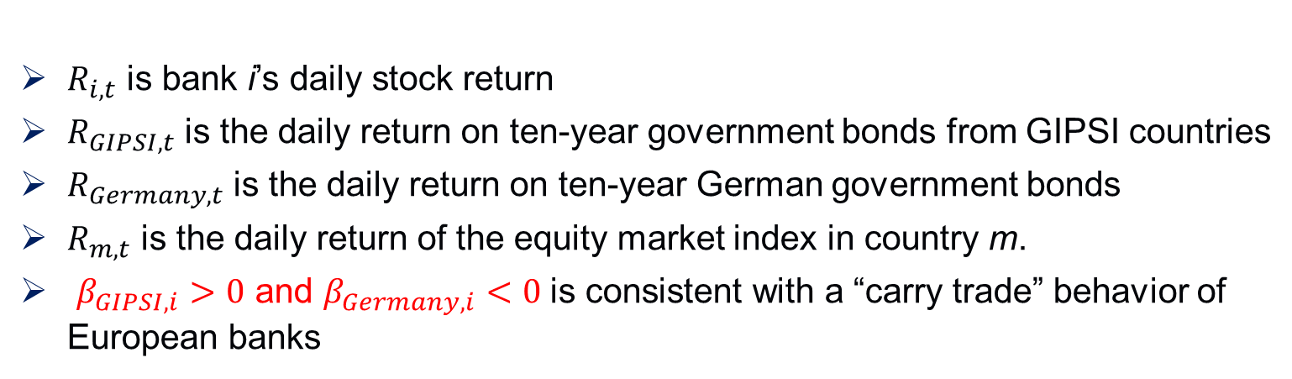
Methodology for capturing this behavior in market data
We use the sensitivity of banks’ stock returns to sovereign bond returns as a measure of banks’ exposure to sovereign debt.
similar to the procedure employed by Agarwal and Naik (2004) to characterize the exposures of hedge funds.
$R_{i,t}=β_{0,i}+β_{GIPSI,i}R_{GIPSI,t}+β_{Germany,i}R_{Germany,t}+β_{m}R_{m,t}+ε_{i,t}$ (1)
$R_{i,t}$ is bank i’s daily stock return
$R_{GIPSI,t}$ is the daily return on ten-year government bonds from GIPSI countries
$R_{Germany,t}$ is the daily return on ten-year German government bonds
$R_{m,t}$ is the daily return of the equity market index in country m.
$β_{GIPSI,i}>0$ and $β_{Germany,i}<0$ is consistent with a “carry trade” behavior of European banks

Slide 21
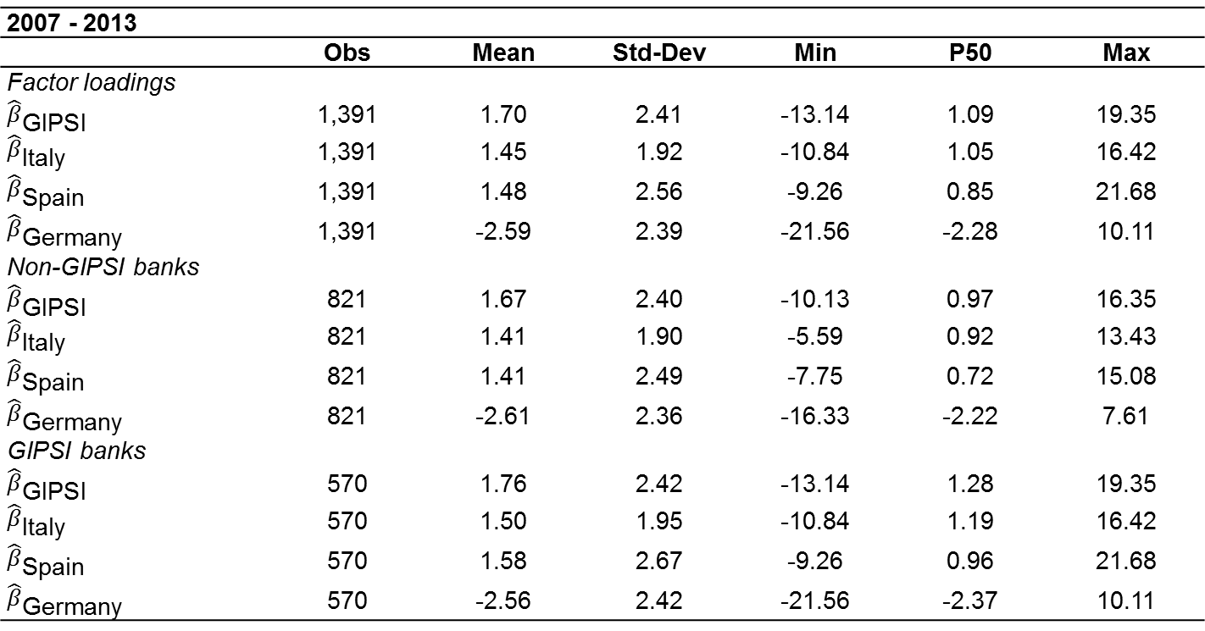
Table 4A. Summary Statistics of Factor Loadings and Bond Holdings
2007 - 2013
 | Obs | Mean | Std-Dev | Min | P50 | Max
Factor loadings
$${\hat{β}}_{\text{GIPSI}}$$ | 1,391 | 1.70 | 2.41 | -13.14 | 1.09 | 19.35
$${\hat{β}}_{\text{Italy}}$$ | 1,391 | 1.45 | 1.92 | -10.84 | 1.05 | 16.42
$${\hat{β}}_{\text{Spain}}$$ | 1,391 | 1.48 | 2.56 | -9.26 | 0.85 | 21.68
$${\hat{β}}_{\text{Germany}}$$ | 1,391 | -2.59 | 2.39 | -21.56 | -2.28 | 10.11
Non-GIPSI banks
$${\hat{β}}_{\text{GIPSI}}$$ | 821 | 1.67 | 2.40 | -10.13 | 0.97 | 16.35
$${\hat{β}}_{\text{Italy}}$$ | 821 | 1.41 | 1.90 | -5.59 | 0.92 | 13.43
$${\hat{β}}_{\text{Spain}}$$ | 821 | 1.41 | 2.49 | -7.75 | 0.72 | 15.08
$${\hat{β}}_{\text{Germany}}$$ | 821 | -2.61 | 2.36 | -16.33 | -2.22 | 7.61
GIPSI banks
$${\hat{β}}_{\text{GIPSI}}$$ | 570 | 1.76 | 2.42 | -13.14 | 1.28 | 19.35
$${\hat{β}}_{\text{Italy}}$$ | 570 | 1.50 | 1.95 | -10.84 | 1.19 | 16.42
$${\hat{β}}_{\text{Spain}}$$ | 570 | 1.58 | 2.67 | -9.26 | 0.96 | 21.68
$${\hat{β}}_{\text{Germany}}$$ | 570 | -2.56 | 2.42 | -21.56 | -2.37 | 10.11
We find a positive correlation between banks’ stock returns and GIPSI bond returns and a negative correlation with German bund returns.

Slide 22
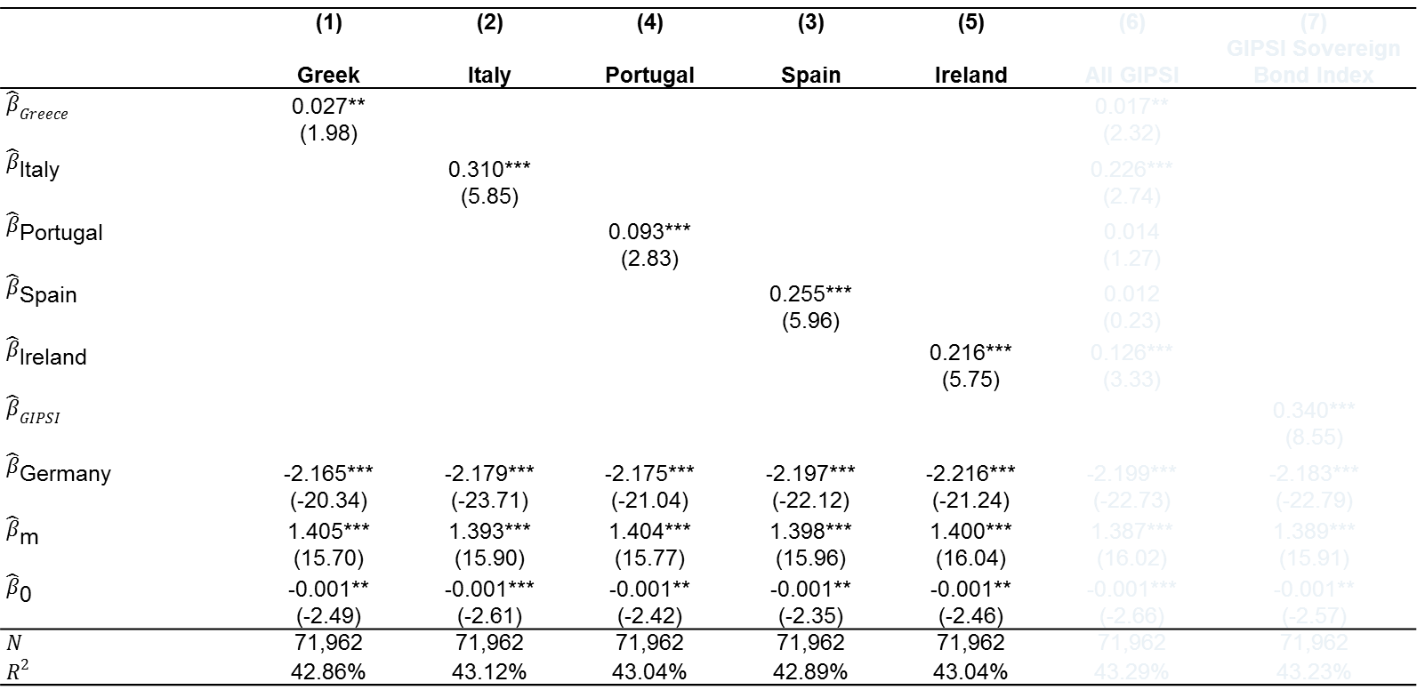
Table 4B. Banks’ Carry Trade Behavior Estimates
$$R_{i,t}=β_{0}+β_{GIPSI}R_{GIPSI,t}+β_{Germany}R_{Germany,t}+{β_{m}R}_{m,t}+ε_{i,t}$$
 | (1) | (2) | (4) | (3) | (5) | (6) | (7)
 | Greek | Italy | Portugal | Spain | Ireland | All GIPSI | GIPSI Sovereign Bond Index
$${\hat{β}}_{Greece}$$ | 0.027** |  |  |  |  | 0.017**
 | (1.98) |  |  |  |  | (2.32)
$${\hat{β}}_{\text{Italy}}$$ |  | 0.310*** |  |  |  | 0.226***
 |  | (5.85) |  |  |  | (2.74)
$${\hat{β}}_{\text{Portugal}}$$ |  |  | 0.093*** |  |  | 0.014
 |  |  | (2.83) |  |  | (1.27)
$${\hat{β}}_{\text{Spain}}$$ |  |  |  | 0.255*** |  | 0.012
 |  |  |  | (5.96) |  | (0.23)
$${\hat{β}}_{\text{Ireland}}$$ |  |  |  |  | 0.216*** | 0.126***
 |  |  |  |  | (5.75) | (3.33)
$${\hat{β}}_{GIPSI}$$ |  |  |  |  |  |  | 0.340***
 |  |  |  |  |  |  | (8.55)
$${\hat{β}}_{\text{Germany}}$$ | -2.165*** | -2.179*** | -2.175*** | -2.197*** | -2.216*** | -2.199*** | -2.183***
 | (-20.34) | (-23.71) | (-21.04) | (-22.12) | (-21.24) | (-22.73) | (-22.79)
$${\hat{β}}_{\text{m}}$$ | 1.405*** | 1.393*** | 1.404*** | 1.398*** | 1.400*** | 1.387*** | 1.389***
 | (15.70) | (15.90) | (15.77) | (15.96) | (16.04) | (16.02) | (15.91)
$${\hat{β}}_{\text{0}}$$ | -0.001** | -0.001*** | -0.001** | -0.001** | -0.001** | -0.001*** | -0.001**
 | (-2.49) | (-2.61) | (-2.42) | (-2.35) | (-2.46) | (-2.66) | (-2.57)
$$N$$ | 71,962 | 71,962 | 71,962 | 71,962 | 71,962 | 71,962 | 71,962
$$R^{2}$$ | 42.86% | 43.12% | 43.04% | 42.89% | 43.04% | 43.29% | 43.23%

Slide 23
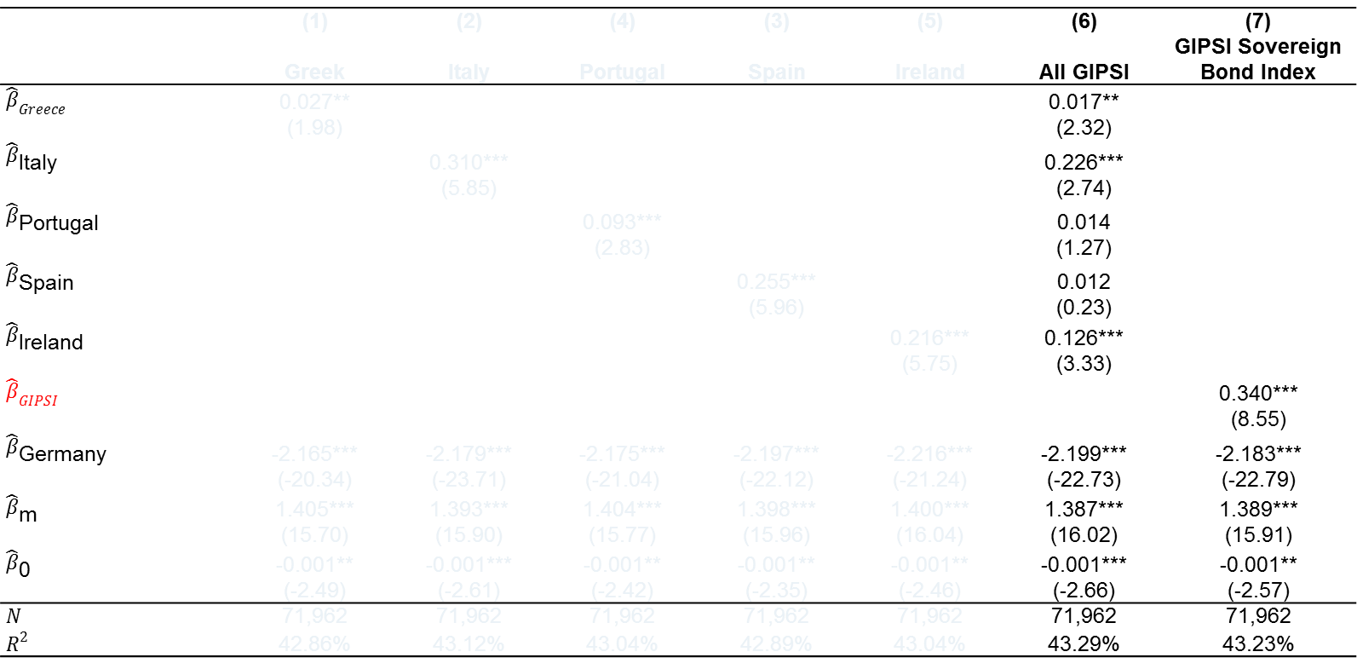
Table 4B. Banks’ Carry Trade Behavior Estimates
$$R_{i,t}=β_{0}+β_{GIPSI}R_{GIPSI,t}+β_{Germany}R_{Germany,t}+{β_{m}R}_{m,t}+ε_{i,t}$$
 | (1) | (2) | (4) | (3) | (5) | (6) | (7)
 | Greek | Italy | Portugal | Spain | Ireland | All GIPSI | GIPSI Sovereign Bond Index
$${\hat{β}}_{Greece}$$ | 0.027** |  |  |  |  | 0.017**
 | (1.98) |  |  |  |  | (2.32)
$${\hat{β}}_{\text{Italy}}$$ |  | 0.310*** |  |  |  | 0.226***
 |  | (5.85) |  |  |  | (2.74)
$${\hat{β}}_{\text{Portugal}}$$ |  |  | 0.093*** |  |  | 0.014
 |  |  | (2.83) |  |  | (1.27)
$${\hat{β}}_{\text{Spain}}$$ |  |  |  | 0.255*** |  | 0.012
 |  |  |  | (5.96) |  | (0.23)
$${\hat{β}}_{\text{Ireland}}$$ |  |  |  |  | 0.216*** | 0.126***
 |  |  |  |  | (5.75) | (3.33)
$${\hat{β}}_{GIPSI}$$ |  |  |  |  |  |  | 0.340***
 |  |  |  |  |  |  | (8.55)
$${\hat{β}}_{\text{Germany}}$$ | -2.165*** | -2.179*** | -2.175*** | -2.197*** | -2.216*** | -2.199*** | -2.183***
 | (-20.34) | (-23.71) | (-21.04) | (-22.12) | (-21.24) | (-22.73) | (-22.79)
$${\hat{β}}_{\text{m}}$$ | 1.405*** | 1.393*** | 1.404*** | 1.398*** | 1.400*** | 1.387*** | 1.389***
 | (15.70) | (15.90) | (15.77) | (15.96) | (16.04) | (16.02) | (15.91)
$${\hat{β}}_{\text{0}}$$ | -0.001** | -0.001*** | -0.001** | -0.001** | -0.001** | -0.001*** | -0.001**
 | (-2.49) | (-2.61) | (-2.42) | (-2.35) | (-2.46) | (-2.66) | (-2.57)
$$N$$ | 71,962 | 71,962 | 71,962 | 71,962 | 71,962 | 71,962 | 71,962
$$R^{2}$$ | 42.86% | 43.12% | 43.04% | 42.89% | 43.04% | 43.29% | 43.23%
GIPSI Sovereign Bond Index is an index of GDP weighted GIPSI sovereign bond returns

Slide 24
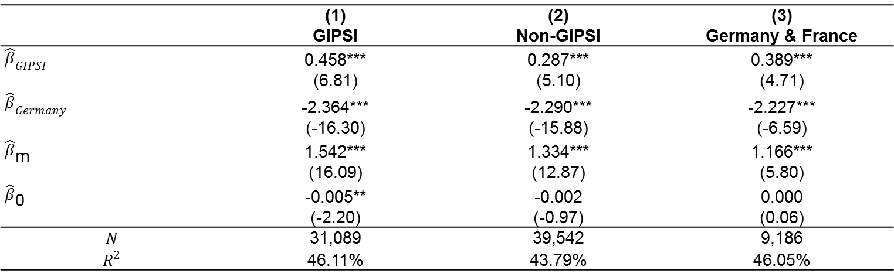
Table 5b. Subsamples: GIPSI versus Non-GIPSI Banks
 | (1) | (2) | (3)
 | GIPSI | Non-GIPSI | Germany & France
$${\hat{β}}_{GIPSI}$$ | 0.458*** | 0.287*** | 0.389***
 | (6.81) | (5.10) | (4.71)
$${\hat{β}}_{Germany}$$ | -2.364*** | -2.290*** | -2.227***
 | (-16.30) | (-15.88) | (-6.59)
$${\hat{β}}_{\text{m}}$$ | 1.542*** | 1.334*** | 1.166***
 | (16.09) | (12.87) | (5.80)
$${\hat{β}}_{\text{0}}$$ | -0.005** | -0.002 | 0.000
 | (-2.20) | (-0.97) | (0.06)
$$N$$ | 31,089 | 39,542 | 9,186
$$R^{2}$$ | 46.11% | 43.79% | 46.05%
An intensification of weak sovereign-bank linkages can potentially explain positive factor loadings
If so, non-GIPIS, and, in particular, German and French banks should not get affected the same way as GIPSI banks do.
Positive factor loadings on non-GIPSI banks supports carry-trade hypothesis.

Slide 25
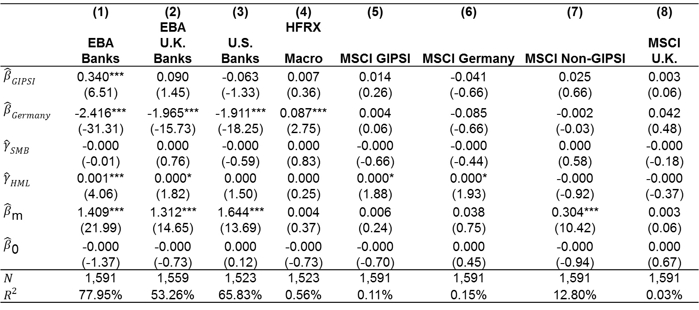
Table 5c. Falsification Tests
 | (1) | (2) | (3) | (4) | (5) | (6) | (7) | (8)
 |  | EBA |  | HFRX
 | EBA Banks | U.K. Banks | U.S. Banks | Macro | MSCI GIPSI | MSCI Germany | MSCI Non-GIPSI | MSCI U.K.
$${\hat{β}}_{GIPSI}$$ | 0.340*** | 0.090 | -0.063 | 0.007 | 0.014 | -0.041 | 0.025 | 0.003
 | (6.51) | (1.45) | (-1.33) | (0.36) | (0.26) | (-0.66) | (0.66) | (0.06)
$${\hat{β}}_{Germany}$$ | -2.416*** | -1.965*** | -1.911*** | 0.087*** | 0.004 | -0.085 | -0.002 | 0.042
 | (-31.31) | (-15.73) | (-18.25) | (2.75) | (0.06) | (-0.66) | (-0.03) | (0.48)
$${\hat{γ}}_{SMB}$$ | -0.000 | 0.000 | -0.000 | 0.000 | -0.000 | -0.000 | 0.000 | -0.000
 | (-0.01) | (0.76) | (-0.59) | (0.83) | (-0.66) | (-0.44) | (0.58) | (-0.18)
$${\hat{γ}}_{HML}$$ | 0.001*** | 0.000* | 0.000 | 0.000 | 0.000* | 0.000* | -0.000 | -0.000
 | (4.06) | (1.82) | (1.50) | (0.25) | (1.88) | (1.93) | (-0.92) | (-0.37)
$${\hat{β}}_{\text{m}}$$ | 1.409*** | 1.312*** | 1.644*** | 0.004 | 0.006 | 0.038 | 0.304*** | 0.003
 | (21.99) | (14.65) | (13.69) | (0.37) | (0.24) | (0.75) | (10.42) | (0.06)
$${\hat{β}}_{\text{0}}$$ | -0.000 | -0.000 | 0.000 | -0.000 | -0.000 | 0.000 | -0.000 | 0.000
 | (-1.37) | (-0.73) | (0.12) | (-0.73) | (-0.70) | (0.45) | (-0.94) | (0.67)
$$N$$ | 1,591 | 1,559 | 1,523 | 1,523 | 1,591 | 1,591 | 1,591 | 1,591
$$R^{2}$$ | 77.95% | 53.26% | 65.83% | 0.56% | 0.11% | 0.15% | 12.80% | 0.03%
Return exposures consistent with carry trade behavior is specific to Euro area banks and not to hedge funds, industrial firms or other banks of Western economies.

Slide 26
Figure 4. Factor Loadings and Bank Portfolio Holdings
We estimate the factor loadings for each bank in the time period 60 days before and 60 days after each reporting date.
Here: Sept.’11, Dec’11 and June’12 for exposure to Italy and Spain.
The scatterplot shows a positive relationship between factor loadings and portfolio holdings.

Slide 27
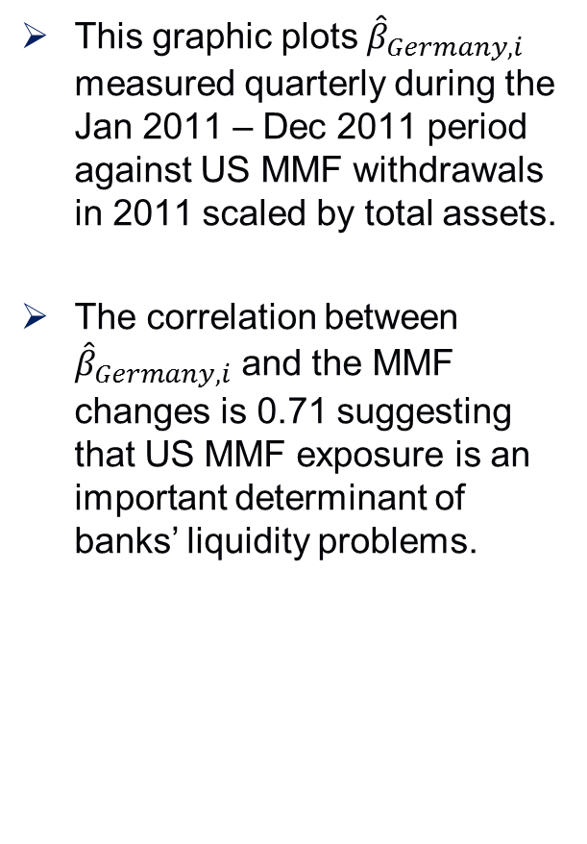
Figure 5. Cross-Sectional Differences
This graphic plots ${\hat{β}}_{Germany,i}$ measured quarterly during the Jan 2011 – Dec 2011 period against US MMF withdrawals in 2011 scaled by total assets.
The correlation between ${\hat{β}}_{Germany,i}$ and the MMF changes is 0.71 suggesting that US MMF exposure is an important determinant of banks’ liquidity problems.

Slide 28
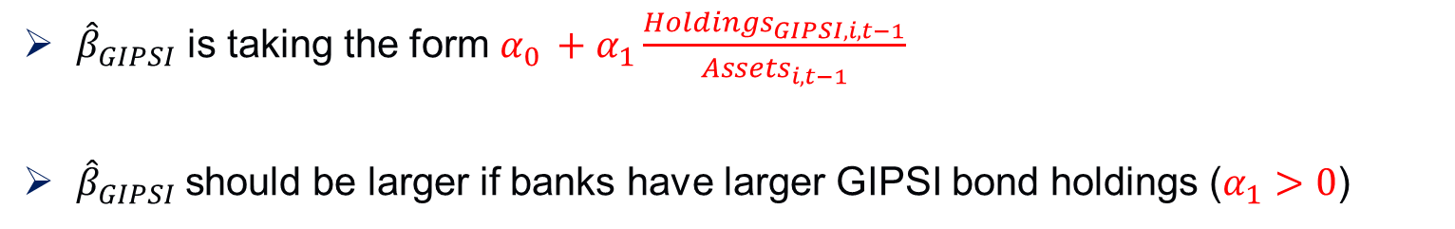

Results from Seemingly Unrelated Regressions
We assess the importance of portfolio holdings of sovereign debt as well as money market fund exposure in explaining our factor loadings in a one-step framework using Zellner’s (1968) seemingly unrelated regression (SUR) technique.
This approach has also been used, for example, in French et al. (1983) to estimate the effects of nominal contracting on stock returns
$$R_{i,t}=β_{0}+α_{0}R_{GIPSI,t}+α_{1}\frac{{Holdings}_{GIPSI,i,t−1}}{{Assets}_{i,t−1}} R_{GIPSI,t}+α_{2}R_{Germany,t}+α_{3}\frac{{Holdings}_{Germany,i,t−1}}{{Assets}_{i,t−1}}R_{Germany,t}+…$$
${\hat{β}}_{GIPSI}$ is taking the form $α_{0 }+α_{1}\frac{{Holdings}_{GIPSI,i,t−1}}{{Assets}_{i,t−1}}$
${\hat{β}}_{GIPSI}$should be larger if banks have larger GIPSI bond holdings ($α_{1}>0$)

Slide 29

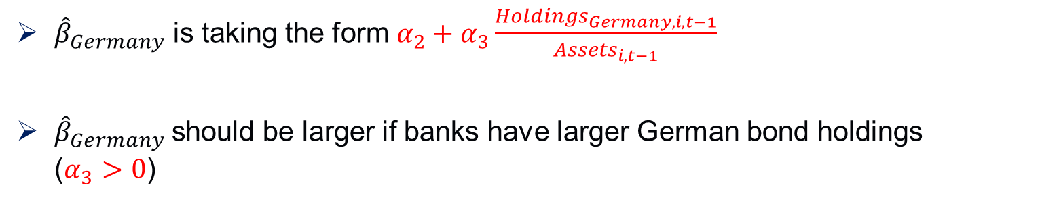
Results from Seemingly Unrelated Regressions
We assess the importance of portfolio holdings of sovereign debt as well as money market fund exposure in explaining our factor loadings in a one-step framework using Zellner’s (1968) seemingly unrelated regression (SUR) technique.
This approach has also been used, for example, in French et al. (1983) to estimate the effects of nominal contracting on stock returns
$$R_{i,t}=β_{0}+α_{0}R_{GIPSI,t}+α_{1}\frac{{Holdings}_{GIPSI,i,t−1}}{{Assets}_{i,t−1}} R_{GIPSI,t}+α_{2}R_{Germany,t}+α_{3}\frac{{Holdings}_{Germany,i,t−1}}{{Assets}_{i,t−1}}R_{Germany,t}+…$$
${\hat{β}}_{Germany}$ is taking the form $α_{2}+α_{3}\frac{{Holdings}_{Germany,i,t−1}}{{Assets}_{i,t−1}}$
${\hat{β}}_{Germany}$should be larger if banks have larger German bond holdings ($α_{3}>0$)

Slide 30
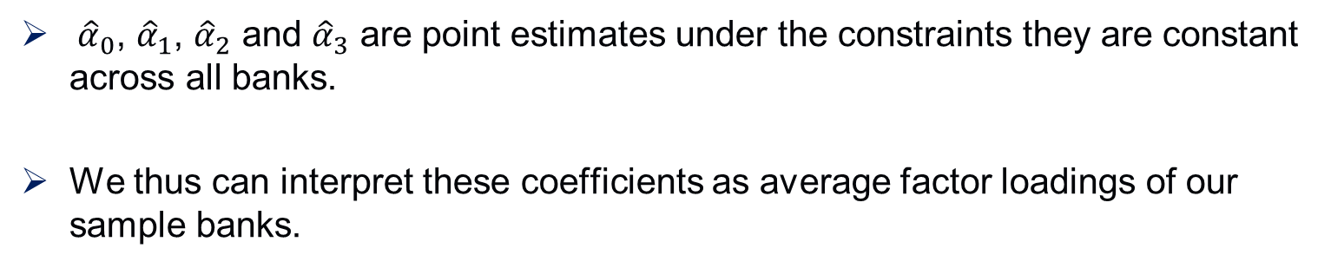
Table 6. Results from Seemingly Unrelated Regressions (cont’d)
GIPSI | α0 | α₁ | α₂ | α3 | Prob > chi²
GIPSI | 0.316*** | 6.423*** | -2.446*** | 4.380*** | <0.001
 | (8.86) | (16.07) | (-37.89) | (2.73)
Italy | 0.365*** | 9.444*** | -2.330*** | 3.664** | <0.001
 | (10.87) | (13.46) | (-31.37) | (2.21)
Spain | 0.381*** | 5.368*** | --2.442*** | 3.690** | <0.001
 | (10.42) | (12.18) | (-38.00) | (2.24)
${\hat{α}}_{0}$, ${\hat{α}}_{1}$, ${\hat{α}}_{2}$ and ${\hat{α}}_{3}$ are point estimates under the constraints they are constant across all banks.
We thus can interpret these coefficients as average factor loadings of our sample banks.

Slide 31
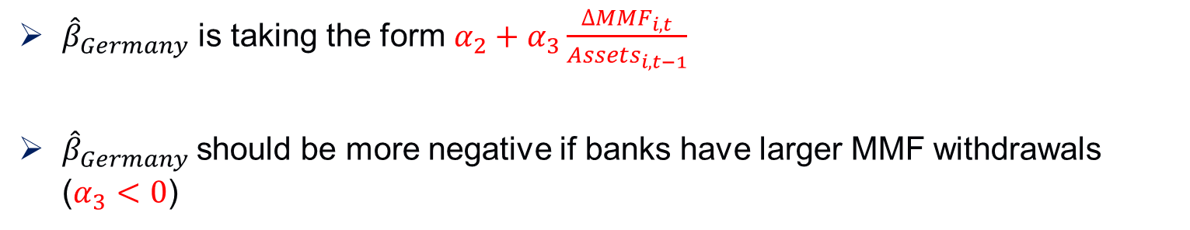
Table 6. Results from Seemingly Unrelated Regressions (cont’d)
$$R_{i,t}=β_{0}+α_{0}R_{GIPSI,t}+α_{1}\frac{{Holdings}_{i,t−1}}{{Assets}_{i,t−1}} R_{GIPSI,t}+α_{2}R_{Germany,t}+α_{3}\frac{{∆MMF}_{i,t}}{{Assets}_{i,t−1}}R_{Germany,t}+…$$
GIPSI | α0 | α₁ | α₂ | α3 | Prob > chi²
GIPSI | 0.310*** | 6.709*** | -2.324*** | -11.595*** | <0.001
 | (6.48) | (12.28) | (-31.75) | (-3.82)
Italy | 0.296*** | 11.203*** | -2.210*** | -8.091*** | <0.001
 | (7.2) | (10.53) | (-25.47) | (-2.58)
Spain | 0.399*** | 4.736*** | -2.32*** | -10.389*** | <0.001
 | (8.29) | (8.9) | (-32.48) | (-3.45)
${\hat{β}}_{Germany}$ is taking the form $α_{2}+α_{3}\frac{{∆MMF}_{i,t}}{{Assets}_{i,t−1}}$
${\hat{β}}_{Germany}$should be more negative if banks have larger MMF withdrawals ($α_{3}<0$)

Slide 32
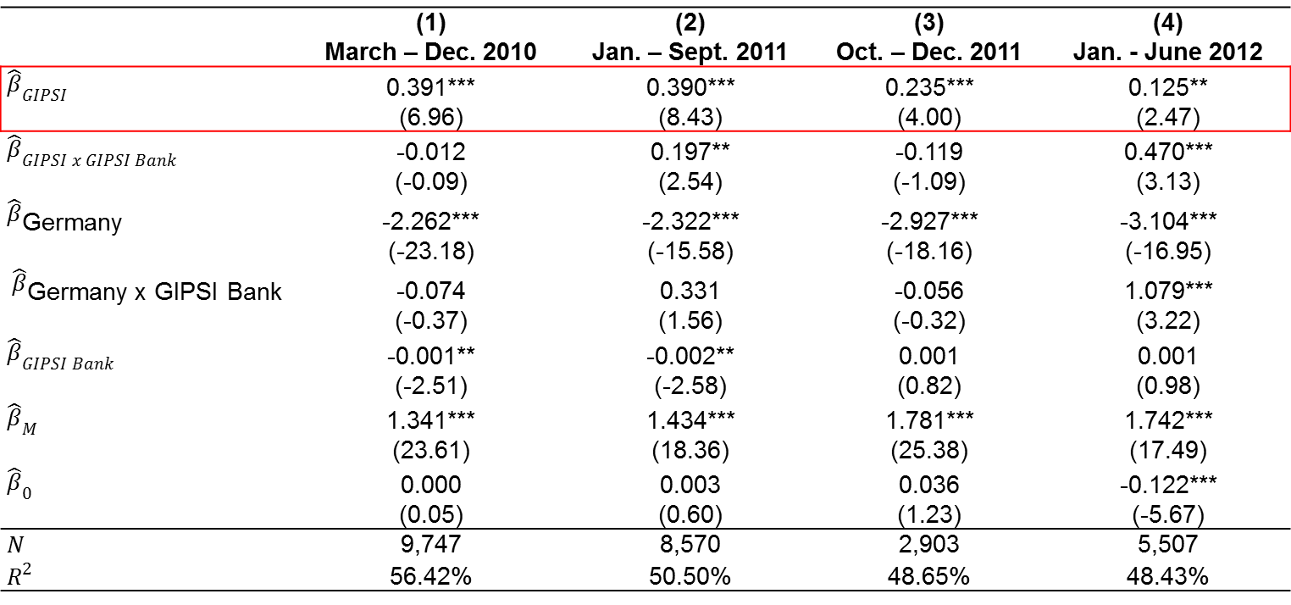
Table 7. Subperiods and Home Bias
 | (1) | (2) | (3) | (4)
 | March – Dec. 2010 | Jan. – Sept. 2011 | Oct. – Dec. 2011 | Jan. - June 2012
$${\hat{β}}_{GIPSI }$$ | 0.391*** | 0.390*** | 0.235*** | 0.125**
 | (6.96) | (8.43) | (4.00) | (2.47)
$${\hat{β}}_{GIPSI x GIPSI Bank }$$ | -0.012 | 0.197** | -0.119 | 0.470***
 | (-0.09) | (2.54) | (-1.09) | (3.13)
$${\hat{β}}_{\text{Germany}}$$ | -2.262*** | -2.322*** | -2.927*** | -3.104***
 | (-23.18) | (-15.58) | (-18.16) | (-16.95)
$${\hat{β}}_{\text{Germany} \text{x} \text{GIPSI} \text{Bank}}$$ | -0.074 | 0.331 | -0.056 | 1.079***
 | (-0.37) | (1.56) | (-0.32) | (3.22)
$${\hat{β}}_{GIPSI Bank }$$ | -0.001** | -0.002** | 0.001 | 0.001
 | (-2.51) | (-2.58) | (0.82) | (0.98)
$${\hat{β}}_{M}$$ | 1.341*** | 1.434*** | 1.781*** | 1.742***
 | (23.61) | (18.36) | (25.38) | (17.49)
$${\hat{β}}_{0}$$ | 0.000 | 0.003 | 0.036 | -0.122***
 | (0.05) | (0.60) | (1.23) | (-5.67)
$$N$$ | 9,747 | 8,570 | 2,903 | 5,507
$$R^{2}$$ | 56.42% | 50.50% | 48.65% | 48.43%
Non-GIPSI banks load heavily on GIPSI sovereign debt and reduce their exposure over time. GIPSI banks increase home bias.
LTROs helped to reduce funding problems primarily of GIPSI banks.

Slide 33
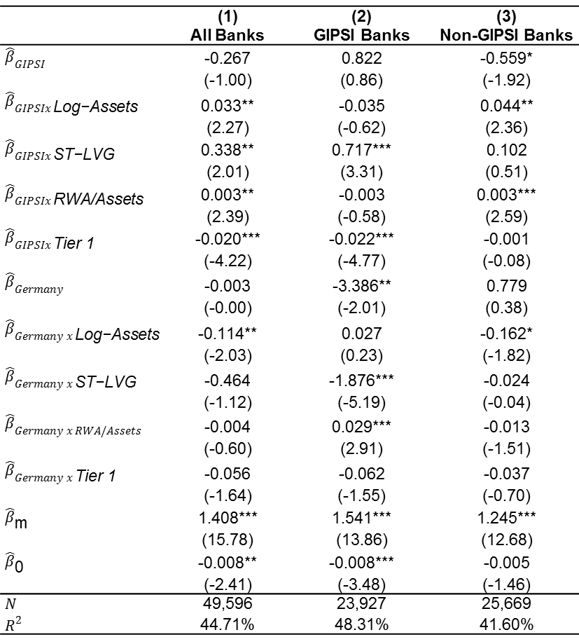
Table 8. Moral Hazard and Regulatory Arbitrage
 | (1) | (2) | (3)
 | All Banks | GIPSI Banks | Non-GIPSI Banks
$${\hat{β}}_{GIPSI}$$ | -0.267 | 0.822 | -0.559*
 | (-1.00) | (0.86) | (-1.92)
$${\hat{β}}_{GIPSIx \text{Log}\text{−}\text{Assets}}$$ | 0.033** | -0.035 | 0.044**
 | (2.27) | (-0.62) | (2.36)
$${\hat{β}}_{GIPSIx \text{ST}\text{−}\text{LVG}}$$ | 0.338** | 0.717*** | 0.102
 | (2.01) | (3.31) | (0.51)
$${\hat{β}}_{GIPSIx \text{RWA}\text{/}\text{Assets}}$$ | 0.003** | -0.003 | 0.003***
 | (2.39) | (-0.58) | (2.59)
$${\hat{β}}_{GIPSIx \text{Tier}\text{ 1}}$$ | -0.020*** | -0.022*** | -0.001
 | (-4.22) | (-4.77) | (-0.08)
$${\hat{β}}_{Germany}$$ | -0.003 | -3.386** | 0.779
 | (-0.00) | (-2.01) | (0.38)
$${\hat{β}}_{Germany x \text{Log}\text{−}\text{Assets}}$$ | -0.114** | 0.027 | -0.162*
 | (-2.03) | (0.23) | (-1.82)
$${\hat{β}}_{Germany x \text{ST}\text{−}\text{LVG}}$$ | -0.464 | -1.876*** | -0.024
 | (-1.12) | (-5.19) | (-0.04)
$${\hat{β}}_{Germany x RWA/Assets}$$ | -0.004 | 0.029*** | -0.013
 | (-0.60) | (2.91) | (-1.51)
$${\hat{β}}_{Germany x \text{Tier}\text{ 1}}$$ | -0.056 | -0.062 | -0.037
 | (-1.64) | (-1.55) | (-0.70)
$${\hat{β}}_{\text{m}}$$ | 1.408*** | 1.541*** | 1.245***
 | (15.78) | (13.86) | (12.68)
$${\hat{β}}_{\text{0}}$$ | -0.008** | -0.008*** | -0.005
 | (-2.41) | (-3.48) | (-1.46)
$$N$$ | 49,596 | 23,927 | 25,669
$$R^{2}$$ | 44.71% | 48.31% | 41.60%
We find that banks with higher Tier 1 capital ratios have lower exposure to GIPSI sovereign debt (risk shifting)
Moreover, the positive coefficient on RWA / Assets (unlike the sign on Tier 1) suggests that there is a regulatory arbitrage motive.
Risk shifting more pronounced among GIPSI banks (Diamon and Rajan, 2011)
Regulatory arbitrage motive particularly among non-GIPSI banks.
Positive coefficient on Log-Assets suggests implicit bailout guarantees from stronger sovereigns.

Slide 34
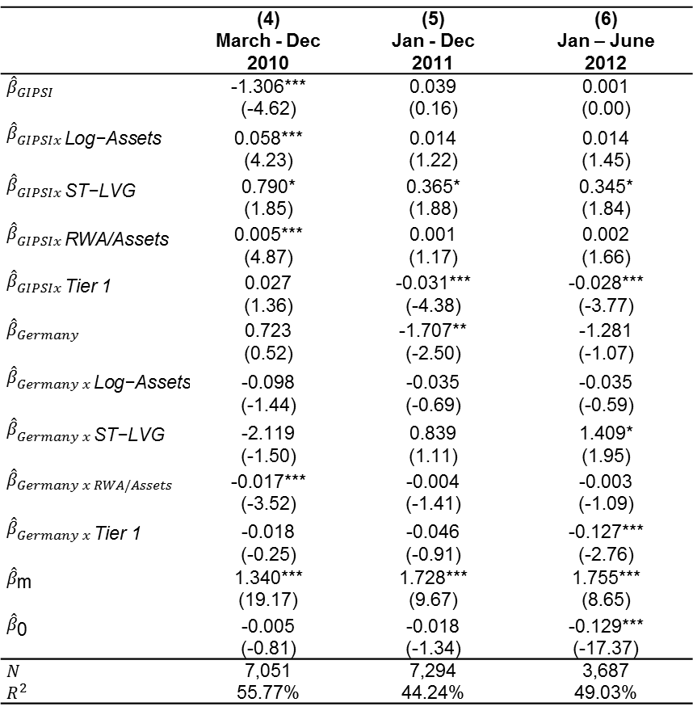
Table 8. Moral Hazard and Regulatory Arbitrage (cont‘d)
 | (4) | (5) | (6)
 | March - Dec 2010 | Jan - Dec 2011 | Jan – June 2012
$${\hat{β}}_{GIPSI}$$ | -1.306*** | 0.039 | 0.001
 | (-4.62) | (0.16) | (0.00)
$${\hat{β}}_{GIPSIx \text{Log}\text{−}\text{Assets}}$$ | 0.058*** | 0.014 | 0.014
 | (4.23) | (1.22) | (1.45)
$${\hat{β}}_{GIPSIx \text{ST}\text{−}\text{LVG}}$$ | 0.790* | 0.365* | 0.345*
 | (1.85) | (1.88) | (1.84)
$${\hat{β}}_{GIPSIx \text{RWA}\text{/}\text{Assets}}$$ | 0.005*** | 0.001 | 0.002
 | (4.87) | (1.17) | (1.66)
$${\hat{β}}_{GIPSIx \text{Tier}\text{ 1}}$$ | 0.027 | -0.031*** | -0.028***
 | (1.36) | (-4.38) | (-3.77)
$${\hat{β}}_{Germany}$$ | 0.723 | -1.707** | -1.281
 | (0.52) | (-2.50) | (-1.07)
$${\hat{β}}_{Germany x \text{Log}\text{−}\text{Assets}}$$ | -0.098 | -0.035 | -0.035
 | (-1.44) | (-0.69) | (-0.59)
$${\hat{β}}_{Germany x \text{ST}\text{−}\text{LVG}}$$ | -2.119 | 0.839 | 1.409*
 | (-1.50) | (1.11) | (1.95)
$${\hat{β}}_{Germany x RWA/Assets}$$ | -0.017*** | -0.004 | -0.003
 | (-3.52) | (-1.41) | (-1.09)
$${\hat{β}}_{Germany x \text{Tier}\text{ 1}}$$ | -0.018 | -0.046 | -0.127***
 | (-0.25) | (-0.91) | (-2.76)
$${\hat{β}}_{\text{m}}$$ | 1.340*** | 1.728*** | 1.755***
 | (19.17) | (9.67) | (8.65)
$${\hat{β}}_{\text{0}}$$ | -0.005 | -0.018 | -0.129***
 | (-0.81) | (-1.34) | (-17.37)
$$N$$ | 7,051 | 7,294 | 3,687
$$R^{2}$$ | 55.77% | 44.24% | 49.03%
Subperiod regressions support risk shifting and regulatory arbitrage motive of banks to invest in sovereign debt.
Risk shifting still important factor when home bias is increasing in later periods.

Slide 35
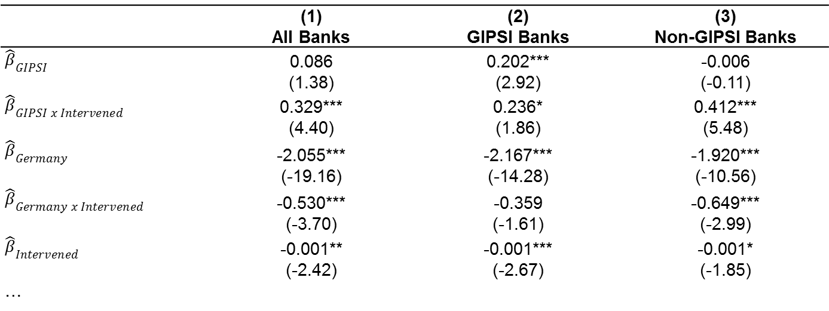
Table 9. Moral Suasion
 | (1) | (2) | (3)
 | All Banks | GIPSI Banks | Non-GIPSI Banks
$${\hat{β}}_{GIPSI}$$ | 0.086 | 0.202*** | -0.006
 | (1.38) | (2.92) | (-0.11)
$${\hat{β}}_{GIPSI x Intervened}$$ | 0.329*** | 0.236* | 0.412***
 | (4.40) | (1.86) | (5.48)
$${\hat{β}}_{Germany}$$ | -2.055*** | -2.167*** | -1.920***
 | (-19.16) | (-14.28) | (-10.56)
$${\hat{β}}_{Germany x Intervened}$$ | -0.530*** | -0.359 | -0.649***
 | (-3.70) | (-1.61) | (-2.99)
$${\hat{β}}_{Intervened}$$ | -0.001** | -0.001*** | -0.001*
 | (-2.42) | (-2.67) | (-1.85)
…
GIPSI banks that have not been bailed out have substantial GIPSI exposures.
Results relating to regulatory arbitrage and moral hazard cannot be explained by moral suasion.
Do large exposures of intervened non-GIPSI banks reflect ill-designed bailout- programs?

Slide 36
Policy Implications
Under-capitalized banking sectors as the European countries had at the end of the financial crisis of 2007-08 can lead to subsequent problems through excess risk-taking comparable to the Japanese experience in 1990s.
Simply restoring bank capitalizations up to regulatory risk weight based requirements does not suffice in environments where the regulatory risk weights have become out of sync with market’s perception of risk of assets.
If risky sovereign debt is accounted for as liquid security under Basel III, this creates similar incentives to load up on these securities.
ECB LTROs apparently have strengthened the financial sector and sovereign’s nexus in the periphery, implying that a further deterioration of the sovereign health would lead to a significant peripheral crisis.
Potential real-sector effects: crowding out of real-sector lending?
Schoenmaker (2013): it is under-capitalized European banks that are not lending

Slide 37
Increase in Home Bias After ECB Dec‘11 and Feb‘12 LTROs
The exposure of core European banks to Italian and Spanish sovereign debt decreased over the March 2010 to June 2012 period.
The exposure of peripheral banks to their domestic sovereign debt increased over the same period.
Italian Bank | % Change (2010) | % Change (2012)
No | 19.26% | -0.86%
Yes | 13.22% | 24.65%
Spanish Bank | % Change (2010) | % Change (2012)
No | 66.34% | -7.69%
Yes | 3.71% | 11.28%
Results indicate an increase in ‘home bias’ over time financed with Dec’11 and Feb’12 LTROs from the ECB
Suggesting that the ECB helps to contain risks within the periphery

Slide 38
Table 3C. Home Bias and LTROs
This table shows changes in Italian / Spanish sovereign bond holdings between Dec‘11 and June’12 (in million euros).
 | Italy |  | Spain
 | <= 3 years | > 3 years | <= 3 years | > 3 years
AT | -473 | -4 | -100 | 1
BE | -137 | -232 | -814 | -189
CY | 30 | -27 | 0 | -5
DE | -48 | 767 | 56 | -588
DK | 158 | 151 | -31 | 8
ES | 1,531 | -2,450 | 6,032 | 6,579
FR | 4,009 | -881 | 345 | 231
GB | -1,468 | -1,791 | -956 | 528
HU | 0 | 0 | 0 | 0
IE | 1 | 15 | -30 | 0
IT | 28,643 | 7,782 | -65 | -271
MT | 0 | 0 | 0 | 0
NL | 230 | -187 | -319 | 142
NO | 0 | 0 | 0 | 0
PT | -1 | 65 | -19 | 27
SE | 11 | -6 | -13 | 0
Banks match the maturities of the securities they purchase with the maturity of ECB funds.
Particularly domestic banks are net purchasers of Italian/Spanish bonds.

Slide 39
Role of ECB Interventions on Carry Trade Profitability
Return of portfolio of EUR 1 invested in Italian sovereign bonds on the date of the 1st LTRO (21 Dec 2011).

Slide 40
CAR of Bond Portfolio Around ECB Interventions
 | Portfolio of Government Bonds Initiated LTRO Dec'11
 | Spain | Italy | Ireland | Portugal | Greece
OMT (6 September 2012)
[-2;+2] | 0.108*** | 0.047*** | 0.018 | 0.079 | 0.111
 | (4.413) | (2.474) | (1.487) | (1.504) | (1.371)
[-1;+1] | 0.075*** | 0.044*** | 0.018* | 0.071* | 0.018
 | (3.298) | (6.88) | (1.796) | (1.885) | (.9)
[-1;0] | 0.048* | 0.031*** | 0.008 | 0.027 | 0.014
 | (1.842) | (4.714) | (.861) | (1.043) | (.588)
Draghi Speech (July 2012)
[-2;+2] | 0.08*** | 0.022 | 0.014 | -0.044 | 0.152
 | (6.171) | (.905) | (1.031) | -(.853) | (1.248)
[-1;+1] | 0.055*** | 0.033*** | -0.002 | -0.031 | 0.101*
 | (4.943) | (2.4) | -(.226) | -(.596) | (1.683)
[-1;0] | 0.035*** | 0.026*** | -0.004 | -0.04 | 0.043
 | (3.314) | (2.625) | -(.571) | -(.779) | (1.305)
We use the market model to calculate expected returns and the JP Morgan EU Government Bond Index as benchmark portfolio and use an estimation period of 180 days before the event date.

Slide 41
CAR – Banks Stock Returns
 |  |  |  | OMT |  | Draghi Speech
 | Bank Stock Prices |  |  | CAR | CAR | CAR | CAR
 |  |  |  | [-1;0] | [-1;0] | [-1;0] | [-1;0]
OMT (6 September 2012)
[-2;+2] | 0.049*** |  | Italy / Assets | 0.325** |  | 0.387***
 | (3.55) |  |  | (.142) |  | (.126)
[-1;+1] | 0.027*** |  | Spain / Assets | .169 |  | 0.564***
 | (4.) |  |  | (.23) |  | (.184)
[-1;0] | 0.013*** |  | Ireland / Assets | .407 |  | 0.865*
 | (2.69) |  |  | (.63) |  | (.469)
Draghi Speech (July 2012) |  |  | Portugal / Assets | .33 |  | -.03
[-2;+2] | 0.014 |  |  | (.224) |  | (.133)
 | (1.64) |  | GIPSI / Assets |  | 0.302*** |  | 0.323***
[-1;+1] | -0.003 |  |  |  | (.112) |  | (.115)
 | -(.35) |  | Log (Assets) | .006 | .005 | .002 | .005
[-1;0] | -0.003 |  |  | (.004) | (.004) | (.004) | (.004)
 | -(.36) |  | Tier 1 - Ratio | -0.002* | -.002 | -.0002 | .001
 |  |  |  | (.001) | (.001) | (.001) | (.001)
 |  |  | RWA / Assets | -.0005 | -.0005 | .0003 | 0.001**
 |  |  |  | (.0004) | (.0004) | (.0003) | (.001)
 |  |  | N | 42 | 42 | 42 | 42
 |  |  | R² | 17.24% | 23.09% | 26.68% | 30.66%
Significant CAR around the OMT announcement, particularly for banks with high exposure to Italian and GIPSI sovereign debt.

Slide 42
Backup

Slide 43
Descriptive Statistics – Bond Holdings
 | Obs | Mean | Std-Dev | Min | Max
GIPSI banks
GIPSI (% Assets) | 70 | 8.69% | 4.79% | 0.67% | 29.59%
NON-GIPSI (% Assets) | 70 | 0.93% | 1.22% | 0.00% | 5.32%
GIPSI (% Total Sov Bonds) | 75 | 88.11% | 14.81% | 48.70% | 100.00%
NON-GIPSI (% Total Sov Bonds) | 75 | 11.89% | 14.81% | 0.00% | 51.30%
Domestic (% Total Sov Bonds) | 86 | 83.90% | 16.04% | 24.32% | 100.00%
NON-GIPSI banks
GIPSI (% Assets) | 145 | 1.21% | 2.32% | 0.00% | 20.33%
NON-GIPSI (% Assets) | 145 | 6.63% | 5.05% | 0.00% | 25.13%
GIPSI (% Total Sov Bonds) | 145 | 15.87% | 23.08% | 0.00% | 99.93%
NON-GIPSI (% Total Sov Bonds) | 145 | 84.13% | 23.08% | 0.07% | 100.00%
Domestic (% Total Sov Bonds) | 154 | 50.97% | 30.57% | 0.00% | 100.00%

Slide 44
Domestic Sovereign Bond Holdings (GIPSI Banks)
Particularly Spanish and Italian banks hold increasingly larger portion of their respective country‘s debt in their portfolios. As of 30 June 2013, e.g., Spanish banks hold 33% of total Spanish goverment debt.
Source: ECB

Slide 45
Peripheral Sovereign Debt Held by Non-GIPSI Banks
Similar to our data, we observe an increase in Italian and Spanish sovereign bond holdings by non-GIPSI banks even until 2nd quarter of 2011.
Source: BIS

Slide 46
Profitability of Carry Trade with Italian Sovereign Debt

Slide 47
Cross-Border Real Sector Exposures
One could argue that our factor loadings reflect cross-border investments of internationally active banks rather than exposure to sovereign debt.
We obtain detailed information about banks’ cross-border real sector investments as of Dec 31st, 2010 from the EBA that has been disclosed in the context of the second stress test in July 2011.
We construct a new variable Real_{GIPSI}/Assets which is the sum of each bank’s exposure to firms, the retail sector (including retail real estate) and commercial real estate scaled by total assets.
Real sector exposures to Spain is constructed accordingly.
Table 7 reports the results of regressions of our factor loadings estimated 60 days before and after 31 Dec 2010 on real sector and sovereign exposure.

Slide 48
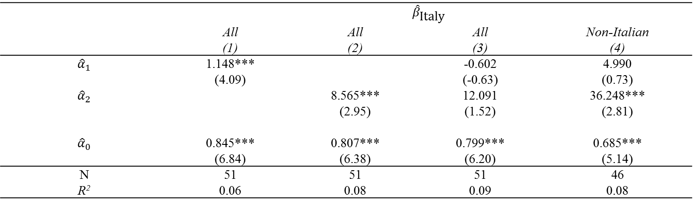
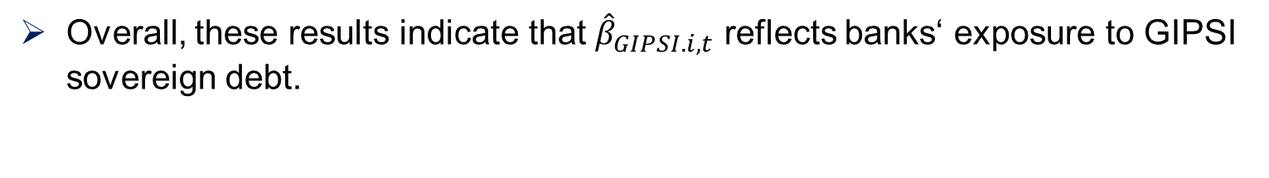
Table 8. Non-Sovereign Cross-Border Exposure of Banks
$${\hat{β}}_{GIPSI.i,t}= α_{0}+α_{1}\frac{{Real}_{GIPSI,i,t}}{{Assets}_{i,t−1}}+α_{2}\frac{{Holdings}_{GIPSI,i,t}}{{Assets}_{i,t−1}}+ω_{i,t}$$
 | $${\hat{β}}_{\text{Italy}}$$
 | All | All | All | Non-Italian
 | (1) | (2) | (3) | (4)
$${\hat{α}}_{1}$$ | 1.148*** |  | -0.602 | 4.990
 | (4.09) |  | (-0.63) | (0.73)
$${\hat{α}}_{2}$$ |  | 8.565*** | 12.091 | 36.248***
 |  | (2.95) | (1.52) | (2.81)
$${\hat{α}}_{0}$$ | 0.845*** | 0.807*** | 0.799*** | 0.685***
 | (6.84) | (6.38) | (6.20) | (5.14)
N | 51 | 51 | 51 | 46
R² | 0.06 | 0.08 | 0.09 | 0.08
Overall, these results indicate that ${\hat{β}}_{GIPSI.i,t}$ reflects banks‘ exposure to GIPSI sovereign debt.

